Slide 1


AI SPECTRUM
Transforming the Future

Slide 2


Introduction
Artificial Intelligence (AI) is the ability of machines to think, learn, and make decisions like humans.
EXAMPLE:
When YouTube or Netflix suggests videos or movies based on what you watch, that is AI in action

Slide 3


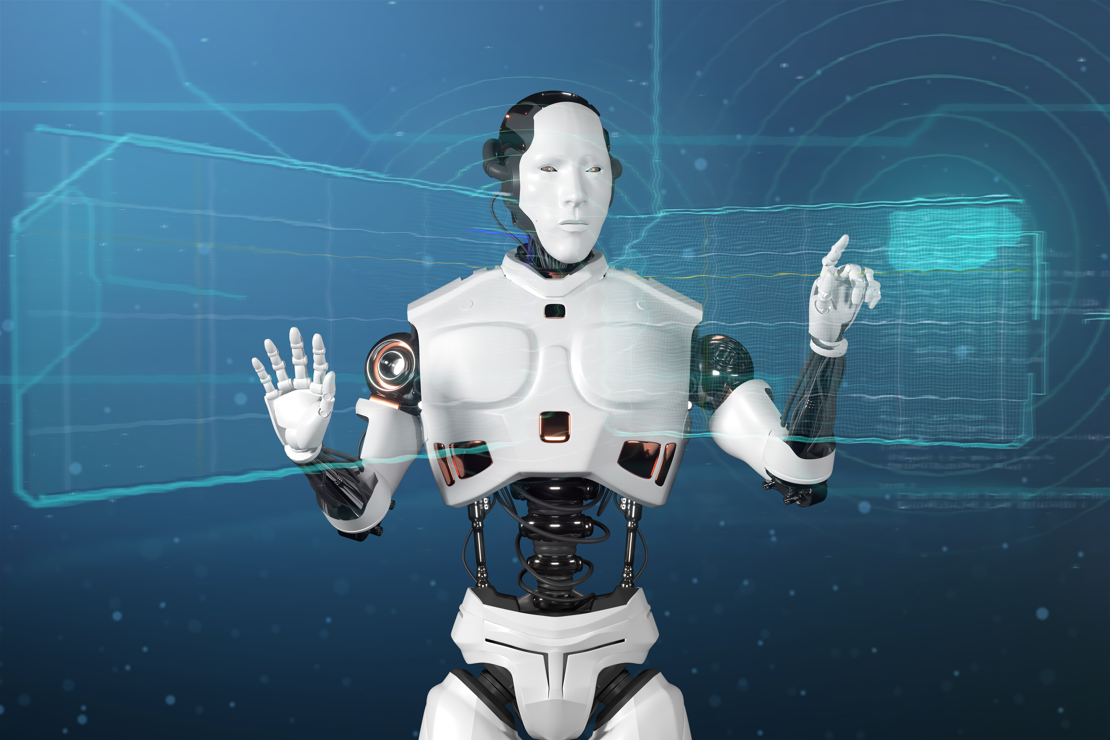
Why Spectrum?
Subtopics :
AI in Edge & IoT Devices
Data Science
Machine Learning
Deep Learning
Generative AI & Autonomous Systems
AI Assistants
AI Ethics & Responsibility
heading
Because AI is not a single technology —
it is a combination of multiple fields working
together to create intelligent systems.

Slide 4
AI in edge and IOT devices
AI at the Edge (Edge AI) means:
AI that runs directly on devices (not only in the cloud)
Data is processed near where it’s generated
Decisions are made locally and in real time
Less need to send data to the internet or cloud
Simple example:
A smart camera that detects faces on the device itself,
instead of sending video to the cloud.
IoT devices (Internet of Things devices) are:
Physical objects connected to the internet
Devices that collect and share data
Equipped with sensors, software, and connectivity
Able to communicate with other devices or systems
Examples of IoT devices:
Smart lights and thermostats
Smart watches and fitness trackers
Smart home appliances (AC, fridge, TV)
Industrial sensors and machines
Smart cameras and meters
n

Slide 5
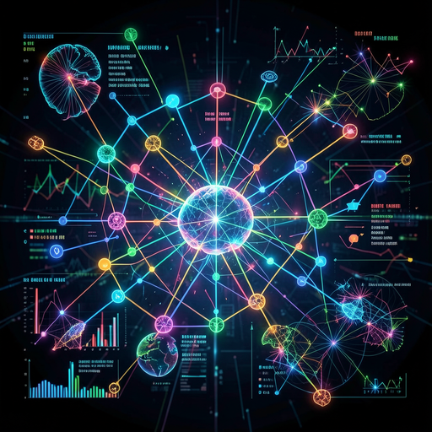
Data Science: The core of intelligent Decison making
Data Science is the discipline that transforms this raw data into meaningful insights. It involves collecting, cleaning, analyzing, and interpreting data to uncover patterns, make predictions, and inform decisions.
By identifying hidden patterns and trends, Data Science empowers organizations to make decisions that are smarter, faster, and more strategic — from operational improvements to high-level business strategies. In essence, Data Science is not just about data; it’s about turning information into action and creating a competitive advantage in a data-driven world.”

Slide 6

Foundation of modern decision making:
Data Science transforms raw data into actionable insights
Integrates statistics, computing, and domain expertise
Enables systematic and objective decision-makingRole in Intelligent Decisions
Analyzes complex datasets to uncover patterns and trends
Uses predictive models to support future-oriented decisions
Enhances strategic, operational, and tactical planningOrganizational Impact
Improves decision accuracy and efficiency
Minimizes risk through data-backed insights
Strengthens innovation and competitive advantage

Slide 7

Machine Learning
Machine Learning Paradigms are different ways/models by which machines learn from data.
They define how data is given and how learning happens.
Choice of paradigm depends on:
1.Availability of labeled data
2.Type of problem (prediction, classification, clustering)
Main types of ML paradigm:
Supervised Learning
Unsupervised Learning
Semi-Supervised Learning
Reinforcement Learning

Slide 8
1. Supervised Learning
Uses labeled data (input + output)
Learns by comparing predicted output with actual output
Examples:
Email spam detection
House price prediction
3. Semi-Supervised Learning
Uses small labeled + large unlabeled data
Reduces labeling cost
Example:
Face recognition systems
2. Unsupervised Learning
Uses unlabeled data
Finds hidden patterns or groups
Examples:
Customer segmentation
Market basket analysis
4. Reinforcement Learning
Learns through reward and punishment
Agent interacts with environment
Examples:
Game playing (Chess, AlphaGo)
Robot navigation

Slide 9
Deep Learning
Deep Learning Neural ArchitecturesDeep learning uses multi-layered neural networks that mimic brain neurons to automatically learn complex patterns from raw data like images, text, or audio.
Core Building Blocks:Neurons & Layers: Input layer receives data; hidden layers extract features; output layer makes predictions.
Activation Functions: ReLU, Sigmoid enable non-linearity for complex modeling.Key Architectures:CNNs: Convolutional layers scan images for edges, shapes (AlexNet, ResNet).
RNNs/LSTMs:
Transformers: Self-attention for parallel NLP processing (BERT, GPT series).
Real Impact: Enables face recognition, chatbots, self-driving cars.

Slide 10
Generative AI
Generative AI creates new content instead of just analyzing data
Can generate text, images, audio, video, and code
Uses models like Large Language Models (LLMs) and Diffusion models
Learns patterns from large datasets
Examples: ChatGPT, DALL·E, Midjourney
Applications:
Content creation and summarization
Chatbots and virtual assistants
Code generation and debugging
Advantages:
Saves time and improves productivity
Enhances creativity
Challenges:
Bias and ethical issues
Incorrect or misleading outputs

Slide 11
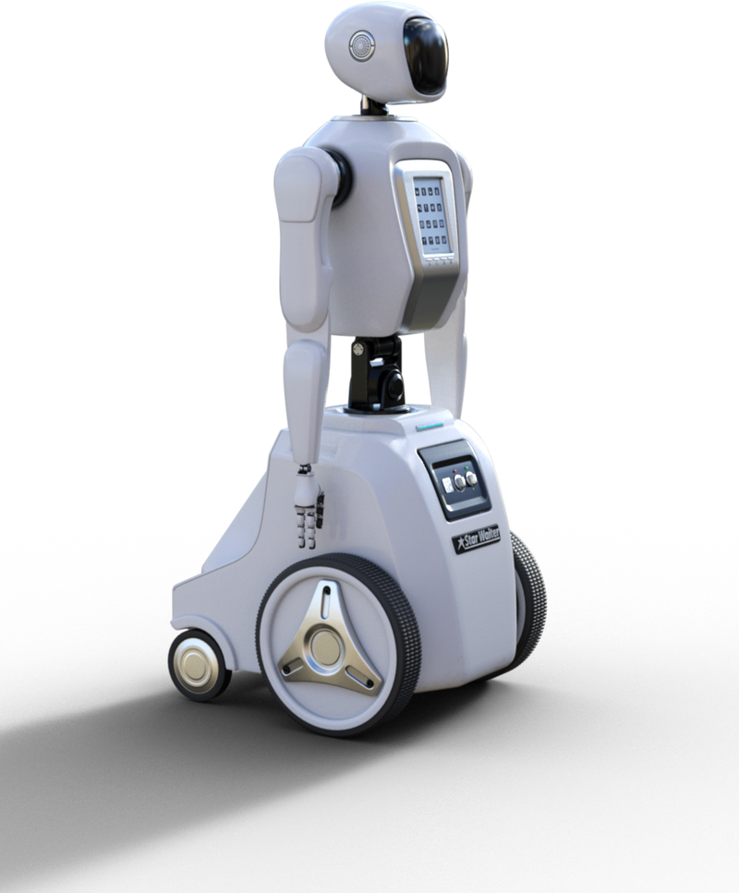
Autonomous System
Autonomous systems can operate independently without human control
Use AI, sensors, and decision-making algorithms
Core components:
Sensors (camera, LiDAR, GPS)
Processing unit (AI models)
Actuators (motors, controls)
Benefits:
Faster decision making
Reduced human effort and errors
Limitations:
Safety and reliability concerns
High development cost
Examples:
Self-driving cars
Drones and robots
Autonomous industrial machines
Applications:
Transportation and logistics
Healthcare and defense
Smart manufacturing

Slide 12


AI Assistants
(like chatgpt ,perplexity and any more)
AI assistants are intelligent software applications designed to help users perform tasks efficiently.
They use Artificial Intelligence, especially Machine Learning and Natural Language Processing (NLP).
These systems can understand human language in the form of text or voice commands.
AI assistants can provide:
Information and answers to queries
Learning and coding assistance
Reminders, scheduling, and task management
They are widely used in education, healthcare, business, and smart devices.
Popular examples include ChatGPT, Google Assistant, Siri, and Alexa.
AI assistants help improve productivity, save time, and make technology more user-friendly....

Slide 13
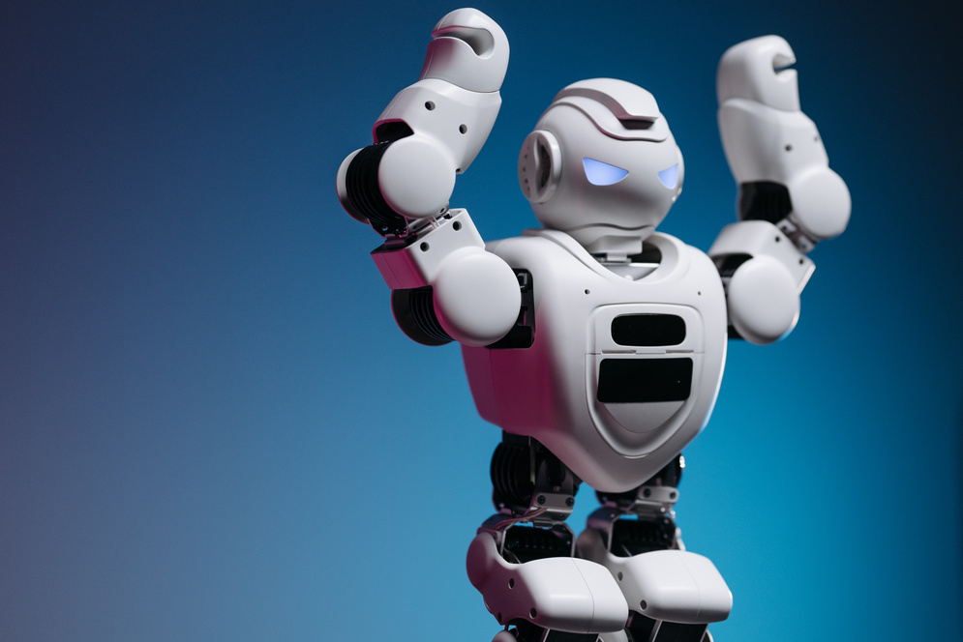
AI ethics(bias,fairness,privacy,AI governance and the responsibility of future engineers)
AI Ethics – Key Concerns
Bias in AI
AI systems can reflect human or data bias
Leads to unfair decisions (gender, caste, race, etc.)
Fairness
AI should treat all individuals equally
Avoid discrimination in hiring, education, healthcare, and finance
Privacy
AI collects and processes large amounts of personal data
Risk of data misuse, surveillance, and data breaches
Transparency
AI decisions should be explainable and understandable
Users must know how and why decisions are made

Slide 14
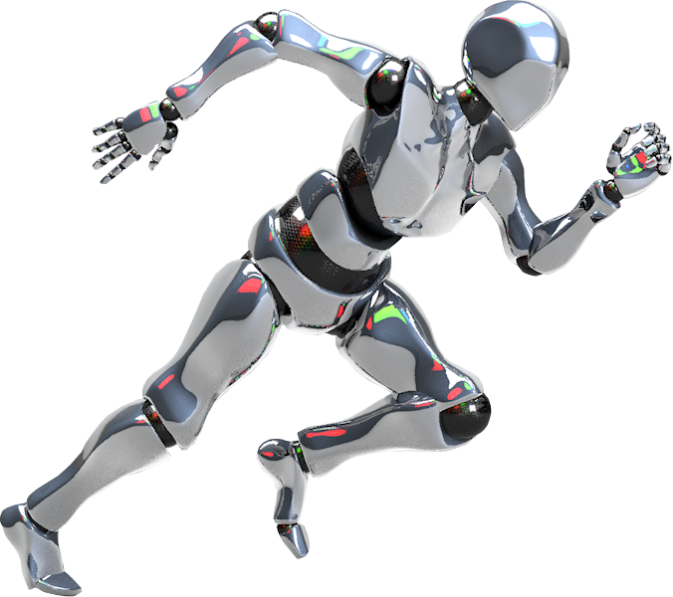
AI Governance & Responsibility of Future Engineers
Laws, policies, and guidelines to regulate AI use
Ensures ethical, legal, and safe AI deployment
Accountability
Clear responsibility for AI outcomes and failures
Organizations must be answerable for AI decisions
Responsibility of Future Engineers
Design bias-free and inclusive AI systems
Protect user data and ensure privacy
Follow ethical standards and societal values
Test AI systems regularly for fairness and safety

Slide 15
Thank You!
presented by-
Anshika Mewar,Akshita Rana,Abhishek Singh Bisht,Akansha Parley,Aditya Rawat,
Aditya Gusain,Agrima Gupta,Amogh Singh Bisht

